Slide 1
Think Outside the Dataset: Finding Fraudulent Reviews using Cross-Dataset Analysis
Shirin Nilizadeh*, Hojjat Aghakhani⁺, Eric Gustafson⁺, Christopher Kruegel⁺, and Giovanni Vigna⁺ * University of Texas at Arlington, ⁺ University of California Santa Barbara

Slide 2
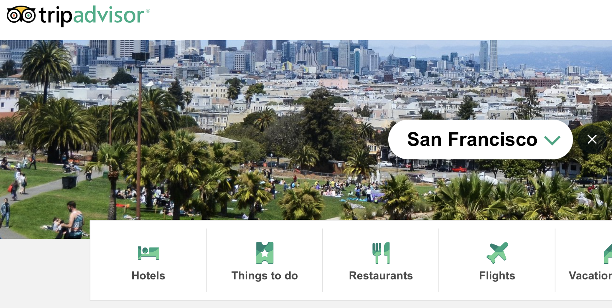
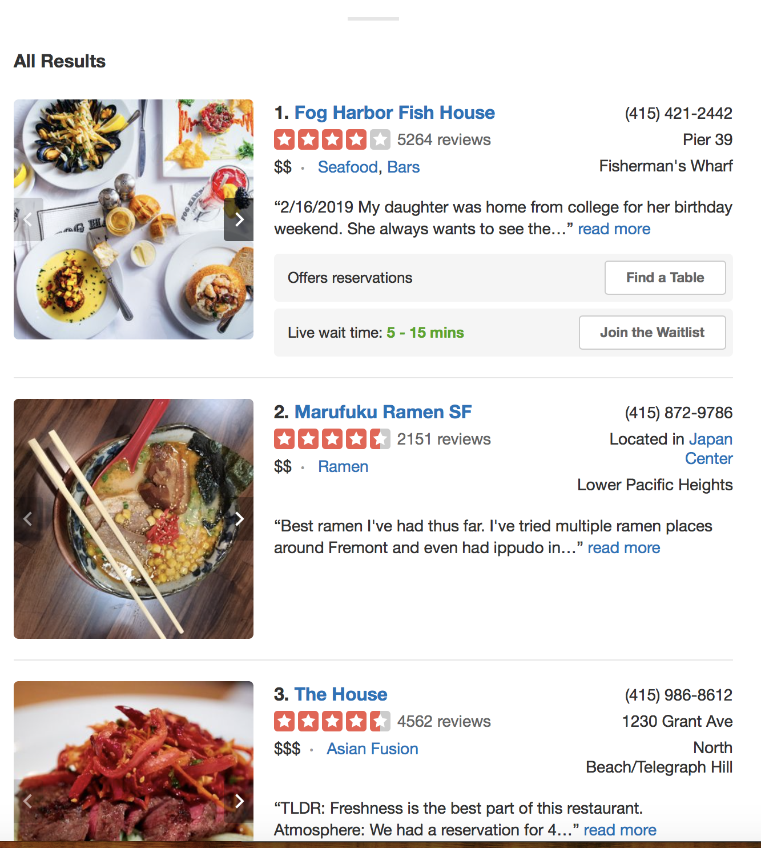

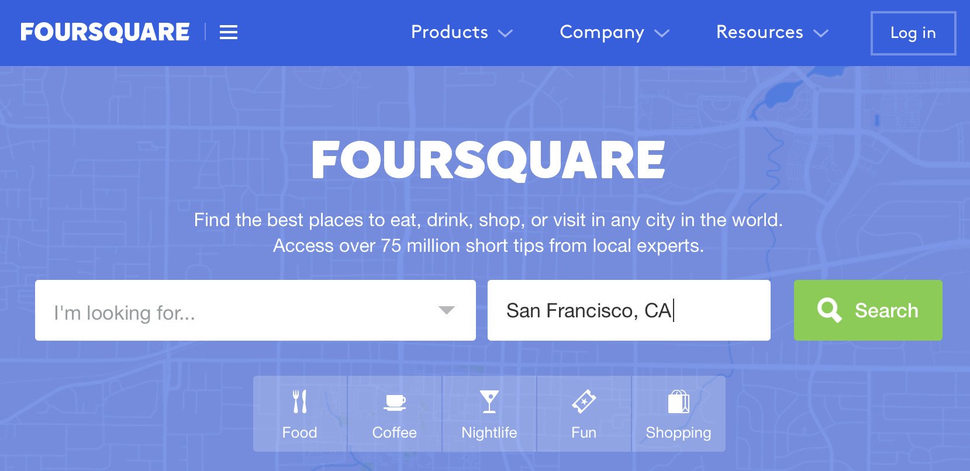
Crowd-sourced reviews on local businesses help both customers and businesses
Notes:
There are many review websites and apps, such as TripAdvisor, Yelp, Foursquare, etc. that allow costumers write reviews for local businesses.
These websites help Customers to find and compare their options, and help businesses to attract more costumers
, specially if they can keep their ratings high.
In fact some studies have shown that an extra star on Yelp, can increase the revenue of a business by 5 to 9 percent.

Slide 3
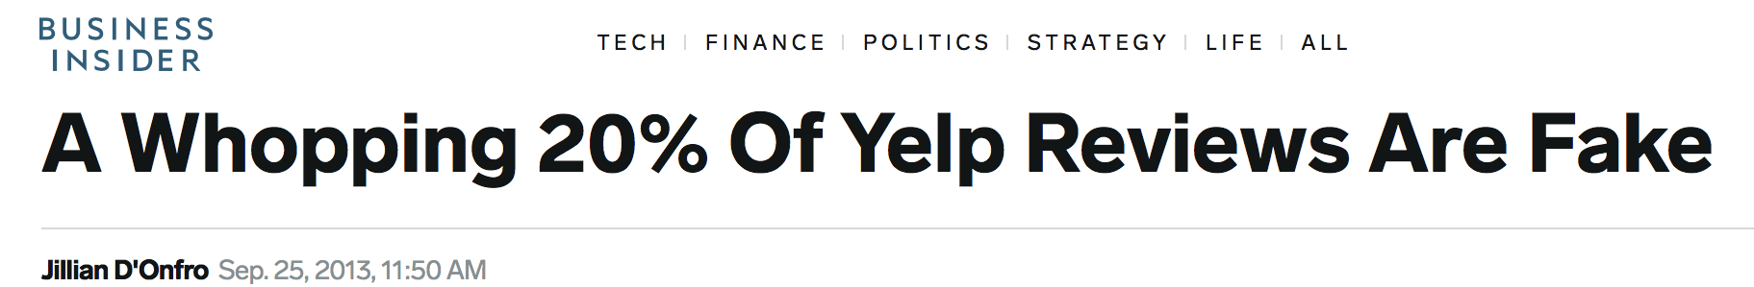
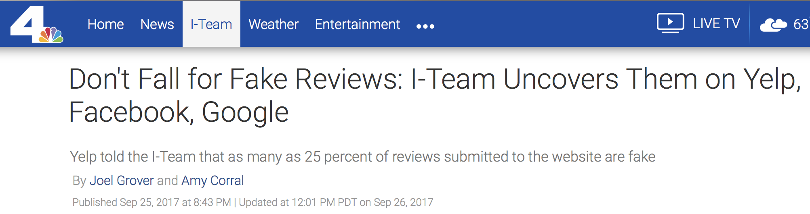
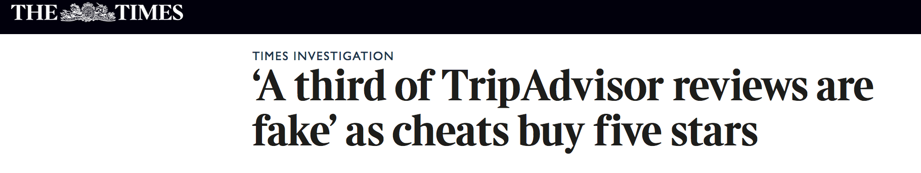
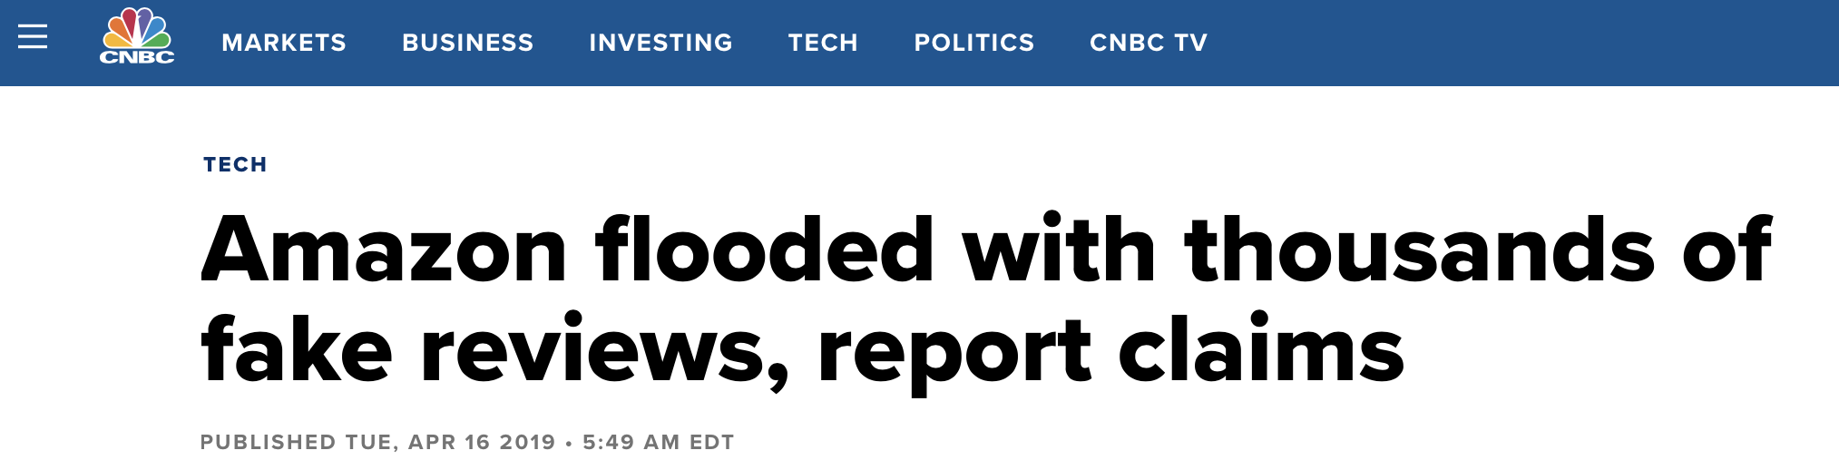
Malicious actors have an equal opportunity to distort the reviews for their own gains
Notes:
These websites also provide an equal opportunity for the Malicious actors to write fake reviews for their own gain.
As you can see in these headlines, this has been a known problem since the invention of these services.

Slide 4

Generating fraudulent reviews is not hard!
The company can craft the false reviews
They can incentivize customers to write them
They can also pay a third party to write them
Notes:
This is because it’s very easy to generate fake reviews, the company can craft the false reviews, incentivize customers to write them and even pay a third party to manage their reputation.
The accounts used for posting fake reviews can be real, fake, or even compromised.

Slide 5
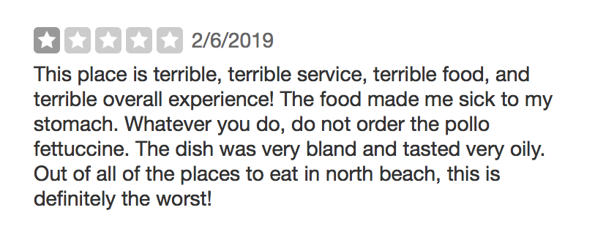
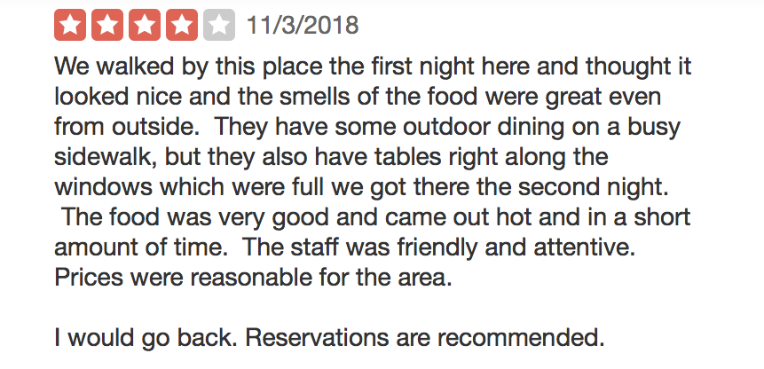
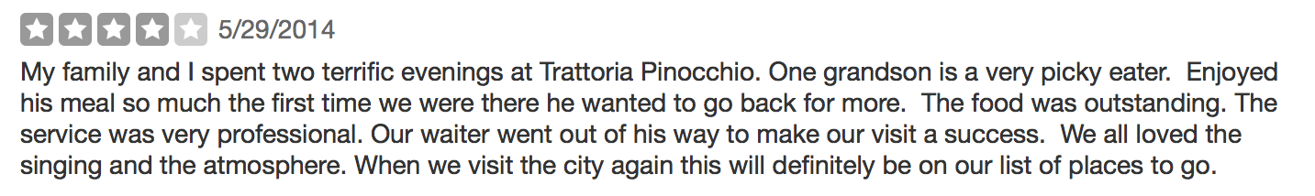
Identifying fraudulent reviews is hard!
Notes:
On the other hand, identifying fake reviews, either manually or automatically is not easy. For example, it’s hard to tell if any of these reviews are fake just by looking at the information.

Slide 6
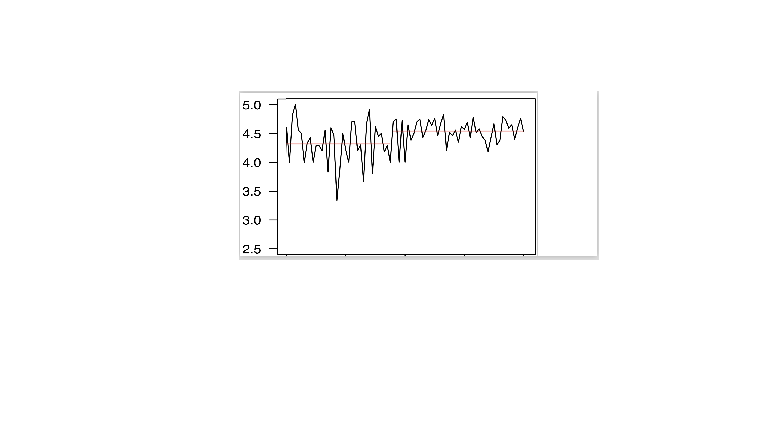
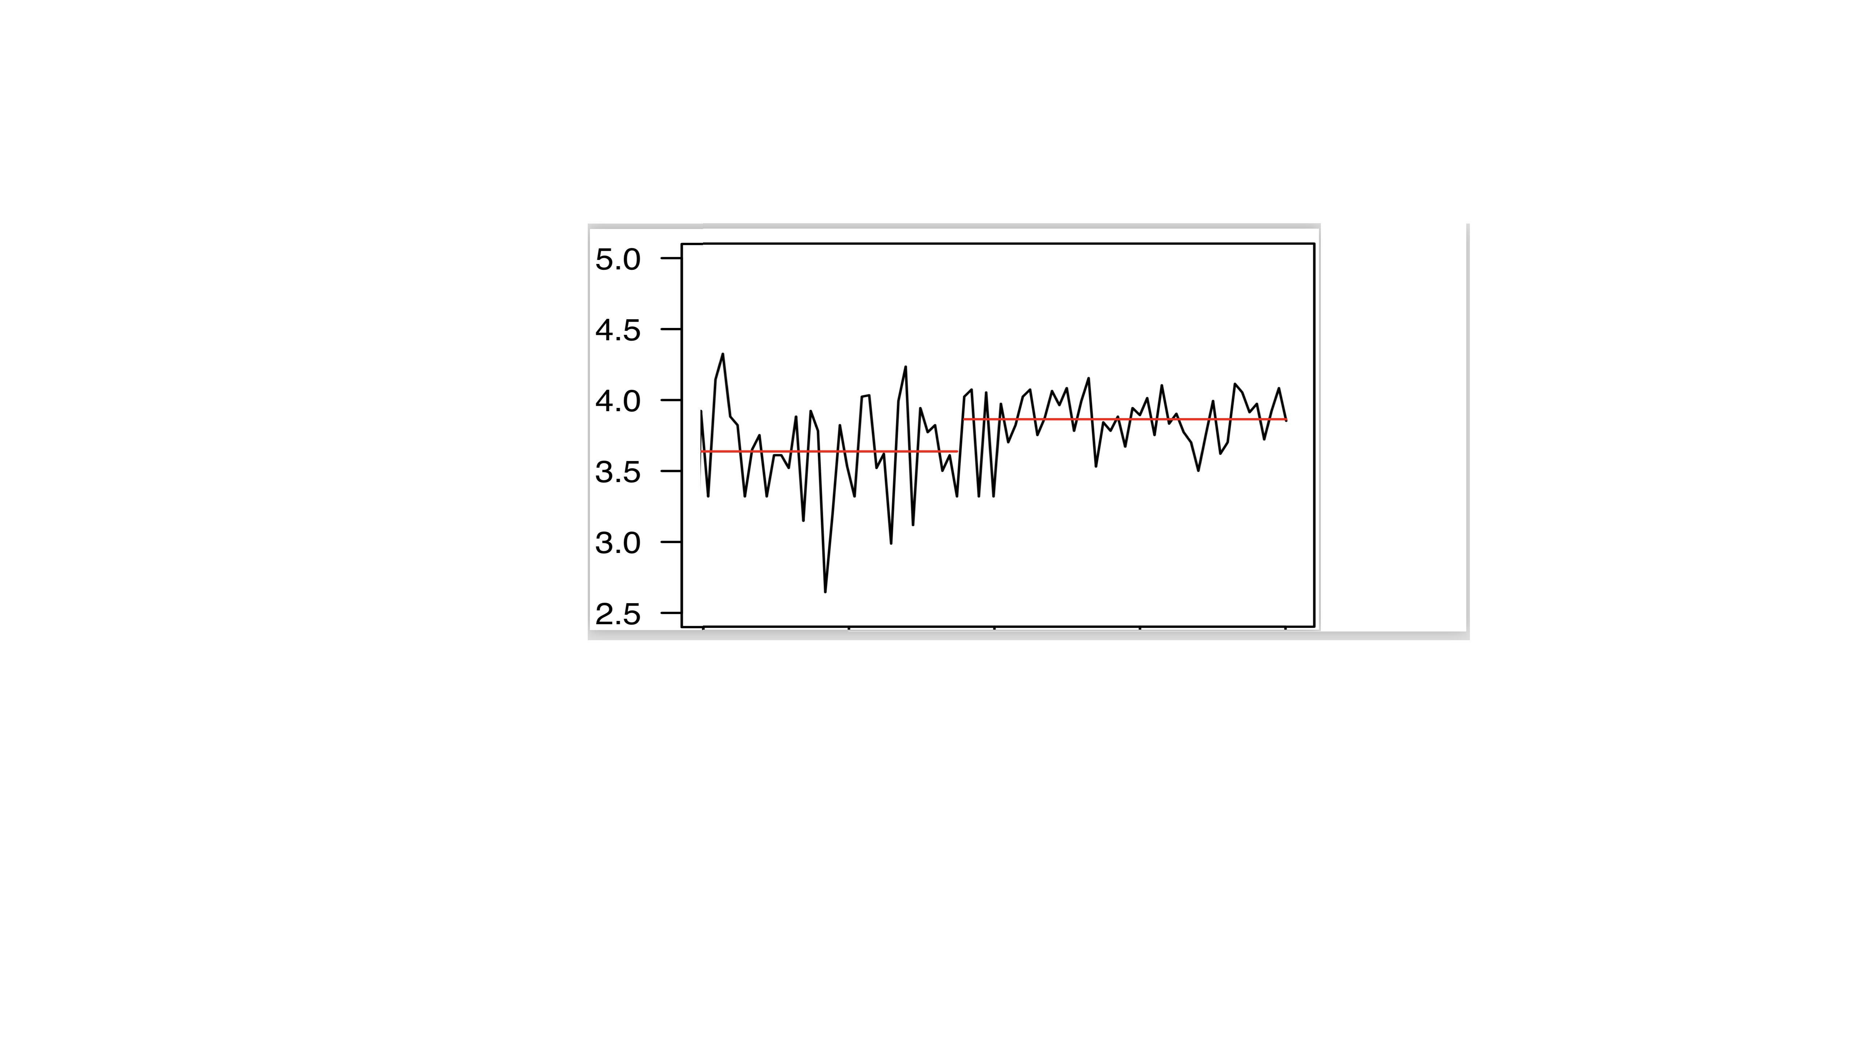
Our idea: The reputation trend of a business should be similar in several review sites
Site 1
Overall Star
Site 2
Overall Star
Reference: https://clipart.wpblink.com/wallpaper-1840058
https://www.123rf.com/photo_37172700_stock-vector-lovely-restaurant-menu-with-cartoon-food-graphics.html
Notes:
Our idea in this research was that over time the reputation trend of a business should be similar in several sites. For example, if a restaurant is doing Okay, and then changes something for the better, e.g., its chef, manager, service, menu, then we should see a shift in the reviews in all the review websites.
For example, if the restaurant changes its chef or manager, then the impact of these changes should appear in all the review websites.

Slide 7
Our idea: Inconsistent changes in a business’ performance across multiple review sites can help locating malicious activity
Site 1
Site 2
Notes:
In other words, if we see inconsistent shifts in the ratings in different websites, then its suspicious.

Slide 8
OneReview analyses data from multiple review sites to help locating suspicious patterns
Notes:
We proposed a system called One Review which analyses data from multiple review websites with the goal of identifying suspicious patterns.
The first step is to obtain data from multiple websites. The second step is to correctly map businesses across the websites.
The third step is to modeling the ratings as of time-series, and identifying the inconsistent shifts in the ratings across websites. Next, we use classical machine learning classifiers to detect fake reviews among these suspicious reviews. Finally, we examined the accounts who has sent the fake reviews, looking for campaigs.

Slide 9
Data Collection
Yelp data challenge:
Restaurants in Pittsburgh, Charlotte, Urbana-Champaign, Phoenix, Las Vegas, Madison, and Cleveland
Obtained 1.4M reviews,16K restaurants and 469K users
Crawled TripAdvisor:
Restaurants in the same cities
Obtained 656K reviews, 10K restaurants, and 305K users
Notes:
We obtained Yelp data from Yelp data challenge. We only focused on restaurants in 7 cities. Then, crawled TripAdvisor to obtain the data for the restaurants in the same cities.
On average, in every city, the Yelp dataset includes about 62% more restaurants, 48% more reviews, and about 62% more reviewers.
Interestingly, businesses on TripAdvisor also obtain higher average star ratings (4.11) compared to businesses on Yelp (3.76)

Slide 10
Matching businesses in Yelp and TripAdvisor
The mapping algorithm is based on name and address
Could match about 6K businesses, thus our final dataset includes:
Yelp dataset with 805K reviews, and 341K users
TripAdvisor dataset with 462K reviews, and 235K users
Manually checked 700 businesses and they are all matched correctly
Notes:
Then, we matched businesses in Yelp and Tripadvisor.

Slide 11
Change Point Analyzer analyses the reputation trends of a business in two websites
Bz₁
Overall Star
Site 1
Vs.
Site 2
Overall Star
We used MeanVar PELT, a multi-change point method, which leverages both mean and variance.
Notes:
A change point occur at time T such that the statistical properties of {} and {} are different in some way.
There are several methods for identifying change-point in a time-series. We used MeanVar PELT, a multi-change point method, which leverages both mean and variance.
There are a variety of Change Point Analysis methods, differing in terms of which statistics they monitor changes in [7, 14, 21, 42, 43]. The most common method is MeanVar PELT [21], a multichanger point method, which leverages both mean and variance.
Change point analysis is a statistical analysis method. Shifts are only detected as change points if they are above certain thresholds and statistically significant.
The number of detected change points then depends on the penalty parameter. A lower penalty value results in more change points being identified, i.e., it is more sensitive.
In our case study of Yelp and TripAdvisor, we tested several values including {p, loд(n), 0.5 ∗ loд(n)}, where n is the number of data points in the time series and p is derived from an “elbow” plot.
Using MeanVar PELT method and penalty= p, we identified 30,496 change points on the Yelp time-series.

Slide 12
Change Point Analyzer analyses the reputation trends of a business in two websites
Bz₁
cps^{src1}=(cp₁, cp₂, …, cp_{k})
Overall Star
Site 1
cps^{src1}=((cp₁, d₁), (cp₂, d₂), …, (cp_{k}, d_{k}))
Site 2
Overall Star
cps^{src2}=(cp₁, cp₂, …, cp_{l})
cps^{src2}=((cp₁, d₁), (cp₂, d₂), …, (cp_{l}, d_{l}))
Notes:
A change point occur at time T such that the statistical properties of {} and {} are different in some way.
There are several methods for identifying change-point in a time-series. We used MeanVar PELT, a multi-change point method, which leverages both mean and variance.
There are a variety of Change Point Analysis methods, differing in terms of which statistics they monitor changes in [7, 14, 21, 42, 43]. The most common method is MeanVar PELT [21], a multichanger point method, which leverages both mean and variance.
Change point analysis is a statistical analysis method. Shifts are only detected as change points if they are above certain thresholds and statistically significant.
The number of detected change points then depends on the penalty parameter. A lower penalty value results in more change points being identified, i.e., it is more sensitive.
In our case study of Yelp and TripAdvisor, we tested several values including {p, loд(n), 0.5 ∗ loд(n)}, where n is the number of data points in the time series and p is derived from an “elbow” plot.
Using MeanVar PELT method and penalty= p, we identified 30,496 change points on the Yelp time-series.

Slide 13
Change Point Analyzer analyses the reputation trends of a business in two websites
For every business, it generates two time-series for its ratings on Yelp and TripAdvisor:
Identifies statistically significant change points, and their direction:
A change point occur at time such that the statistical properties of and are different in some way.
The most common method is MeanVar PELT, a multi-change point method, which leverages both mean and variance.
Notes:
There are a variety of Change Point Analysis methods, differing in terms of which statistics they monitor changes in [7, 14, 21, 42, 43]. The most common method is MeanVar PELT [21], a multichanger point method, which leverages both mean and variance.
Change point analysis is a statistical analysis method. Shifts are only detected as change points if they are above certain thresholds and statistically significant.
The number of detected change points then depends on the penalty parameter. A lower penalty value results in more change points being identified, i.e., it is more sensitive.
In our case study of Yelp and TripAdvisor, we tested several values including {p, loд(n), 0.5 ∗ loд(n)}, where n is the number of data points in the time series and p is derived from an “elbow” plot.
Using MeanVar PELT method and penalty= p, we identified 30,496 change points on the Yelp time-series.

Slide 14
Detecting Suspicious Change Points
Compares Yelp vs. TripAdvisor’s change-points.
At time window w₀, if a change-point exists in both sources, then check if their directions are the same.
If only one source has a change-point, then compare the change-points in neighbor time windows.
Benign
Suspicious
Suspicious
Benign
Notes:
Second, at time windoww0, a change pointmaybe detected insrc1 but not in src2 (scenarios C andDin Figure 3). This can indicate a suspicious behavior, however it is also can be due to the sparsity of data in src2. In other words, sometimes there is a delay in genuine change points simply because no review is provided for the business at some specific date. To minimize the false positives resulting from this phenomenon, When at timew0 only a change point is detected insrc1 and not insrc2 ,CPA extends the comparison to changepoints in neighbor time windows,w−1 andw1.
In particular, if in src2, in time w−1, any change point exists, then if the direction of any of the detected change points matches with that of the change point in src1, then that change point in src1 is labeled as benign (scenario C in Figure 2), otherwise as suspicious scenario D in Figure 2).
With penalty= p, CPA identified 26,835.

Slide 15
OneReview employs machine learning to identify fake reviews within the suspicious review set
Review-based Features:
n-grams, Similarity Score, Sentiment, Text Length, and Review Usefulness
Author-based Features:
Author Overall Review Stars Distribution, Author “Fresh” Review Stars Distribution, Friend Count, Elite Score, Author Review Count, Author Star Similarity, Overall Author Usefulness, and Fresh Author Usefulness
Business-based Features:
Business Overall Review Stars Distribution, Business Fresh Review Stars Distribution, Business Fresh Review Stars Distribution, and Business Star Similarity
Notes:
Textual and contextual features:

Slide 16
Ground truth dataset
Obtaining Fraudulent Labeled Data:
379 Yelp “Not Recommended” reviews that are also among suspicious reviews
370 Yelp-to-Yelp duplicate reviews, and
92 crowd-labeled fraudulent reviews (Amazon Mechanical Turk)
Obtaining Benign Labeled Data
46K useful reviews by Elites
614 reviews by trusted real-life acquaintances
Notes:
There is no pre-existing, and reliable ground truth corpus of fraudu- lent reviews (discussed in Section 2). We employed a combination of human workers and algorithms to create a ground truth dataset of real-world fraudulent reviews. One major advantage of this dataset is that it includes both the text of the reviews and their metadata.
Using Mturk: from 1,700 reviews, we obtained 92 fraudulent reviews.
Unbalanced Dataset
Benign: 4,814 reviews
fake: 841 reviews

Slide 17
Classification
Random Forest
Unbalanced dataset: 4,814 genuine and 841 fake reviews
k-fold cross validation, k=5
Features | Accuracy | F1-score | Precision | Recall
All | 0.97 (+/- 0.01) | 0.90 (+/- 0.04) | 0.91 (+/- 0.03) | 0.90 (+/- 0.06)
Textual | 0.86 (+/- 0.01) | 0.59 (+/- 0.05) | 0.55 (+/- 0.05) | 0.64 (+/- 0.11)
Notes:
Using only textual features (TF-IDFs and sentiment features): the performance is poor with 55% precision and 64% recall.
Since similarity, review usefulness, and Elite scores are used in the creation of the ground truth dataset, we did not use these features for classification.

Slide 18
Impact of Change Point Analysis
MeanVar PELT method (with penalty=p) detected about 30K change points.
Change Point Analyzer identified about 26K change points as suspicious, which consists of about 73K suspicious reviews.
The machine learning classifier detected 62K fraudulent reviews (about 85% of the suspicious and 8% of all the 805K Yelp reviews.)
Notes:
OneReview next employs machine learning using the textual and contextual features to identify fraudulent reviews within this set.

Slide 19
Examining Fraud Campaigns: Untrustworthy Accounts
Identified about 58K untrustworthy users
8% of them have more than 40% of their reviews being fraudulent.
12% of them have only posted one review, and it’s fake.
Notes:
Examining fraud campaigns that post orchestrated reviews to influence the reputation of businesses.
Untrustworthy Accounts. We analyzed untrustworthy accounts, i.e., Yelp users who have posted fraudulent reviews. In total, 58,157 untrustworthy accounts are identified (17% of total Yelp users). We found that about 8% of them (i.e., 7,064) have only posted one fake review. In the Yelp dataset, 27,347 of users only posted one review. Thus, OneReview does not simply identify every reviewer with one review as a untrustworthy account. Moreover, 14,910 of them are mainly posting fraudulent reviews with more than 40% of their reviews being fraudulent. This can indicate untrustworthy accounts who post legitimate reviews in an attempt to avoid the detection.

Slide 20
Examining Fraud Campaigns targeting specific businesses
66% of businesses have received fraudulent reviews.
65% of fraudulent reviews are positive and 35% are negative.
501 of businesses have only received positive, and 344 only received negative fraudulent reviews
Notes:
Examining fraud campaigns that post orchestrated reviews to influence the reputation of businesses.
Untrustworthy Accounts. We analyzed untrustworthy accounts, i.e., Yelp users who have posted fraudulent reviews. In total, 58,157 untrustworthy accounts are identified (17% of total Yelp users). We found that about 8% of them (i.e., 7,064) have only posted one fake review. In the Yelp dataset, 27,347 of users only posted one review. Thus, OneReview does not simply identify every reviewer with one review as a untrustworthy account. Moreover, 14,910 of them are mainly posting fraudulent reviews with more than 40% of their reviews being fraudulent. This can indicate untrustworthy accounts who post legitimate reviews in an attempt to avoid the detection.

Slide 21
Examining Fraud Campaigns: Socially-Networked Fraud Campaigns
A set of untrustworthy users can simply add each other as friends.
Constructed the social network of untrustworthy users,
and used the Louvain community detection algorithm to obtain those who are densely connected to each other.
Notes:
While most communities are small, some include several hundreds of \spammer{}s, \textit{e.g.,} the top 5 largest communities include 1671, 1428, 1385, 565, and 539 spammers.
We examined these campaigns, and found some patterns that can indeed distinguish them as \spammer{}s.
As an example, we found 40 \spammer{}s from a campaign which posted 40 \fake for a single restaurant.
These 40 users, between them have ever posted only 90 reviews, all within a month, spread across 47 distinct venues, while all sharing one venue in common.

Slide 22
Summary
Presented an approach for finding fraudulent activity in crowd-sourced review services, using correlated analysis across multiple independent services.
Developed a more diverse ground truth dataset of reviews from Yelp.
The results from our case study using Yelp and TripAdvisor illustrate that this approach is highly effective in detecting undiscovered fraudulent reviews.

